Slide 1




Defense Jury
SuperNanny
Enhancing Linux Security Through System Call Interception
CAILLEAUX Tanguy
CATALA Alexandre
MATILLA-NORO Lorenzo
VERNANCHET Louis

Slide 2

1
Project context and client
CAILLEAUX, CATALA, MATILLA-NORO, VERNANCHET

Slide 3
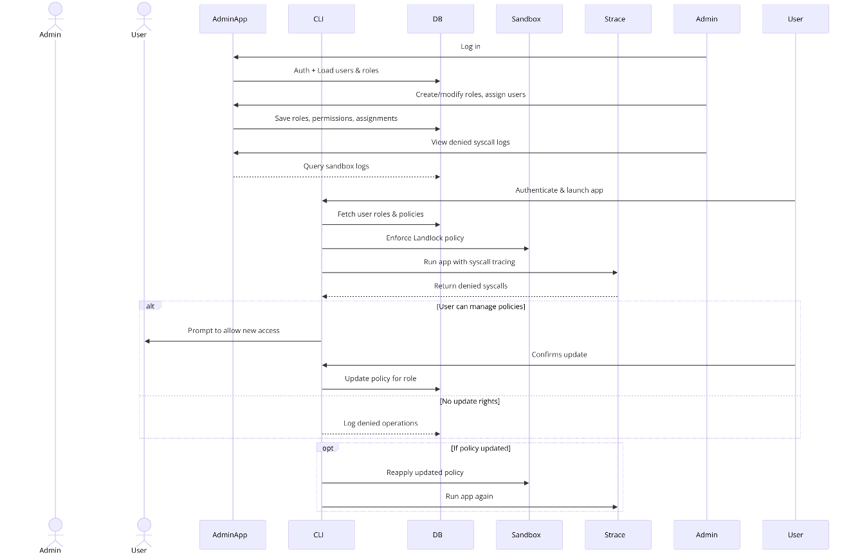
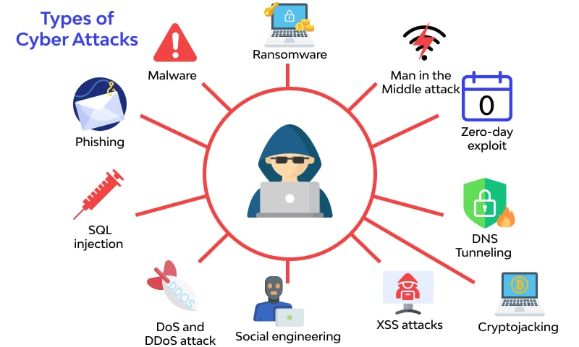
1. Project Context
Sequence Diagram of SuperNanny
Linux Security Threats
CAILLEAUX, CATALA, MATILLA-NORO, VERNANCHET
Notes:
Key Points:
Cybersecurity Challenges in Linux Systems
Linux, despite its robust security, is vulnerable to malware, unauthorized system access, and sandbox escapes.
System administrators lack a built-in way to dynamically restrict application behavior.
SuperNanny’s Role in Solving These Issues
A Linux kernel module that monitors and intercepts system calls before execution.
Uses Landlock to enforce strict security policies dynamically.
Local use

Slide 4
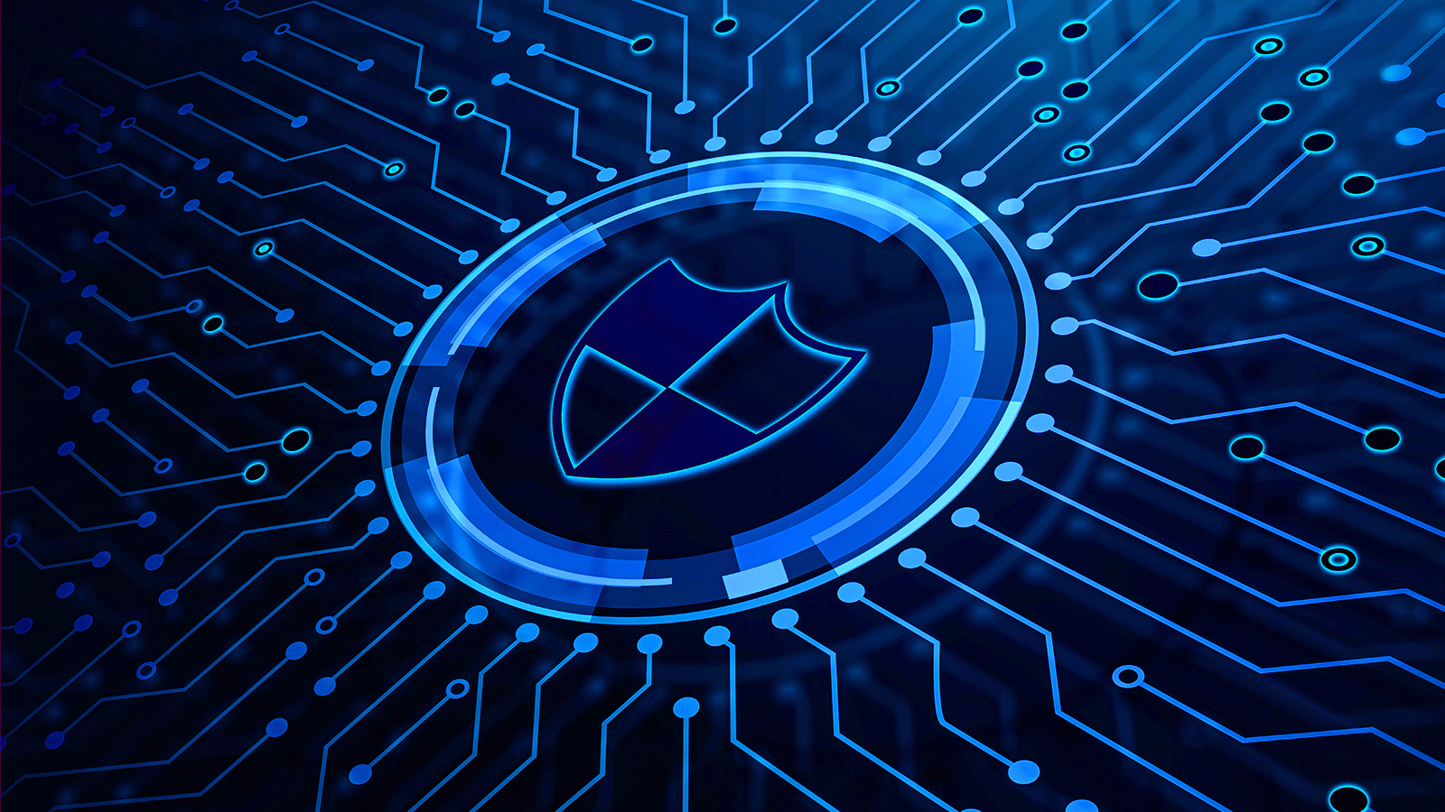

1. Client
About ISEN Méditérranée
Client’s expectation
Linux systems need enhanced execution security
SuperNanny aims to provide real-time application monitoring and control
ISEN supports the project, ensuring technical expertise and infrastructure
CAILLEAUX, CATALA, MATILLA-NORO, VERNANCHET
Notes:
About ISEN Méditerranée
A leading engineering school specialized in cybersecurity, embedded systems, and IT.
Provides infrastructure, guidance, and industry expertise to support the project.
The project aligns with ISEN’s mission to develop real-world security solutions for Linux-based environments.
Client’s Expectations
A functional security module that integrates into existing Linux distributions.
A demonstration of performance and security improvements using real-world attack scenarios.
A scalable and well-documented solution for further development.

Slide 5
1
Project content and client
2
Customer requirements
CAILLEAUX, CATALA, MATILLA-NORO, VERNANCHET

Slide 6
2. Customer requirements
Key Requirements
Secure Execution Monitoring
Linux Kernel Integration
Access Control Enforcement
Scalability
Performance Efficiency
Deliverables Expected by the Client
A functionnal kernel module
Real-world testing
Clear documentation
CAILLEAUX, CATALA, MATILLA-NORO, VERNANCHET
Notes:
Key Requirements from ISEN Méditerranée
Secure Execution Monitoring: The system must monitor and intercept application executions to enforce security policies dynamically.
Linux Kernel Integration: The solution should function at the system level, ensuring minimal performance overhead.
Access Control Enforcement: Originally planned via Landlock, the system should prevent unauthorized file or system resource access.
Scalability: The architecture should be deployable on Kubernetes, supporting large-scale infrastructure.
Performance Efficiency: The project should minimize latency and resource consumption, ensuring usability in production environments.
✅ Deliverables Expected by the Client:
A functional kernel module for secure execution monitoring.
Real-world testing on Linux distributions (Ubuntu, Kali, etc.).
Clear documentation for potential future developments.

Slide 7
1
Project content and client
2
Customer requirements
3
Customer constraints
CAILLEAUX, CATALA, MATILLA-NORO, VERNANCHET

Slide 8








3. Customer constraints
Initial Plan
Why we shifted to eBPF & C ?
CAILLEAUX, CATALA, MATILLA-NORO, VERNANCHET
Notes:
Initial Plan: Rust + Landlock
Rust: Initially chosen for its memory safety, Rust turned out to be difficult for direct kernel module development due to compatibility constraints.
Landlock: While Landlock provides sandboxing capabilities, it has strict limitations, making it hard to implement dynamic access control beyond file access.
Why We Shifted to eBPF & C?
eBPF (Extended Berkeley Packet Filter)
Provides high-performance monitoring by hooking into syscalls.
Allows for dynamic security policy enforcement without major kernel modifications.
Used by major Linux security tools (e.g., Falco, Cilium).
C Language
Offers direct kernel access, making syscall interception and execution control more flexible.
More compatible with eBPF, reducing development complexity.

Slide 9
1
Project content and client
2
Customer requirements
3
Customer constraints
4
Envisioned solution
CAILLEAUX, CATALA, MATILLA-NORO, VERNANCHET

Slide 10
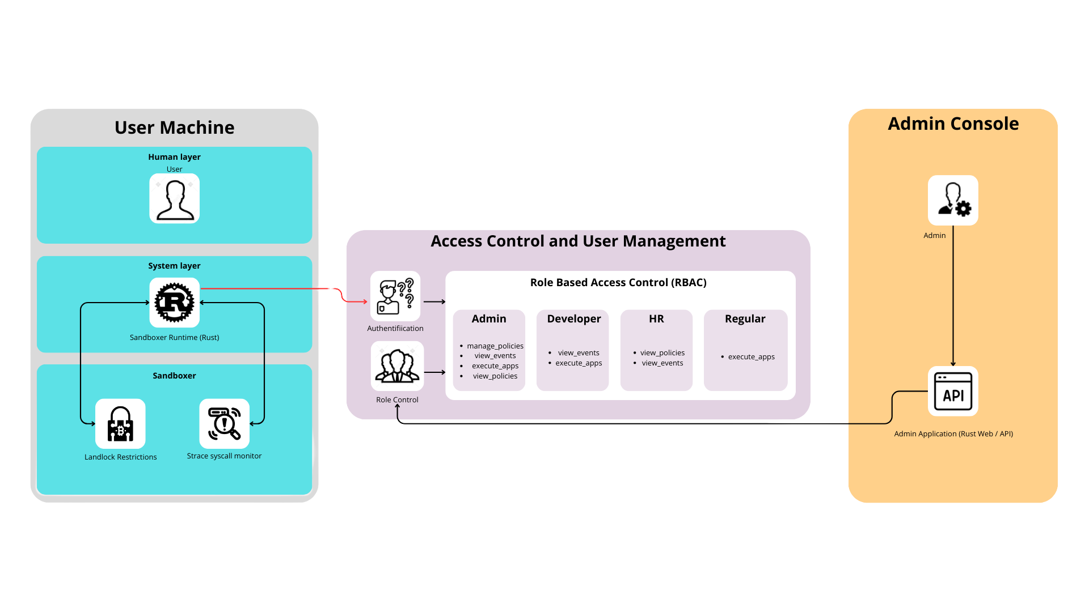
4. Static architecture
CAILLEAUX, CATALA, MATILLA-NORO, VERNANCHET
Notes:
2. Key Architectural Components (Left Side of Slide)
1️⃣ User Application (Executable Program)
Any user-launched application (e.g., ls, cat, a custom executable).
Intercepts execution before system calls are processed.
2️⃣ SuperNanny Kernel Module (eBPF + C)
Intercepts and monitors system calls.
Dynamically applies security policies to allow or block execution.
3️⃣ Security Policy Database
Stores rules for permitted and restricted executions.
Can be updated dynamically based on administrative control.
4️⃣ Logging & Alert System
Monitors security events and logs them for analysis.
Can trigger real-time alerts if an unauthorized execution occurs.

Slide 11
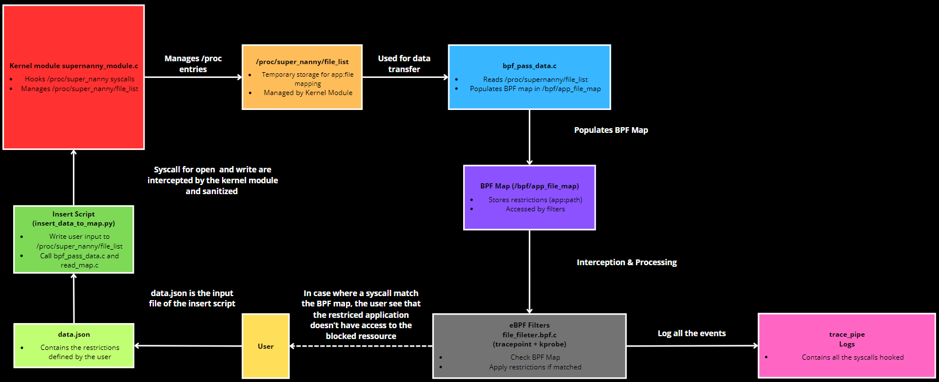
4. Dynamic architecture
CAILLEAUX, CATALA, MATILLA-NORO, VERNANCHET

Slide 12
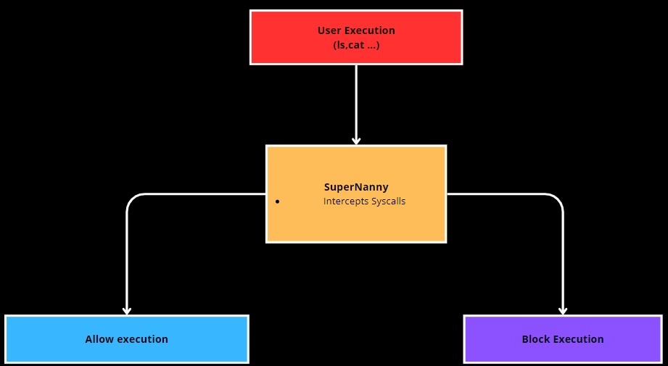
4. Use cases
SuperNanny enforces security policies at execution time
System administrators can dynamically update rules
The solution scales with Kubernetes for enterprise deployment
CAILLEAUX, CATALA, MATILLA-NORO, VERNANCHET
Notes:
2. Use Cases (Left Side of Slide - Bullet Points)
1️⃣ Standard User Execution Monitoring
A user launches a program (ls, cat, or a custom executable).
SuperNanny intercepts the system call before execution.
It verifies permissions in the Security Policy Database.
Execution is either allowed or blocked based on predefined security rules.
2️⃣ Unauthorized Execution Attempt
A user attempts to execute a restricted binary or script.
SuperNanny detects the attempt and blocks it.
A real-time alert is logged to notify administrators.
3️⃣ System Administrator Modifying Security Policies
An admin wants to update execution permissions for a specific user or program.
They update the Security Policy Database via CLI or UI.
SuperNanny applies the new rules dynamically without requiring a system reboot.
4️⃣ Kubernetes Scaling in a Cloud Environment
A company deploys SuperNanny across multiple machines via Kubernetes.
Security policies are synchronized across all nodes to enforce consistent access control.
Logs and security events are collected centrally for monitoring.
3. Diagram (Right Side of Slide - Suggested Design)
Illustrate the use cases with a flow diagram showing:
User attempting to execute a program → Interception by SuperNanny → Execution allowed or blocked.
Admin modifying security policies → Database update → Policy applied dynamically.
SuperNanny deployed in Kubernetes → Multiple machines enforcing the same security rules.

Slide 13
1
Project content and client
2
Customer requirements
3
Customer constraints
4
Envisioned solution
5
Justification of technical choices
CAILLEAUX, CATALA, MATILLA-NORO, VERNANCHET

Slide 14
5. Justification of technical choices
Problems | Solutions
Rust kernel setup was too complex | Moved to C and eBPF
Debugging eBPF tracepoints was difficult | Used procfs and /sys/fs/bpf maps
Understanding Landlock documentation | Shifted to a fully eBPF-based approach
CAILLEAUX, CATALA, MATILLA-NORO, VERNANCHET

Slide 15
1
Project content and client
2
Customer requirements
3
Customer constraints
4
Envisioned solution
5
Justification of technical choices
6
WBS organisation
CAILLEAUX, CATALA, MATILLA-NORO, VERNANCHET

Slide 16
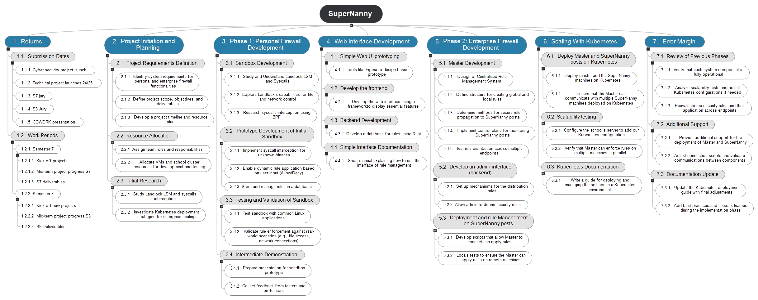
6. WBS organisation
CAILLEAUX, CATALA, MATILLA-NORO, VERNANCHET

Slide 17
1
Project content and client
2
Customer requirements
3
Customer constraints
4
Envisioned solution
5
Justification of technical choices
6
WBS organisation
Forward planning
7
CAILLEAUX, CATALA, MATILLA-NORO, VERNANCHET

Slide 18
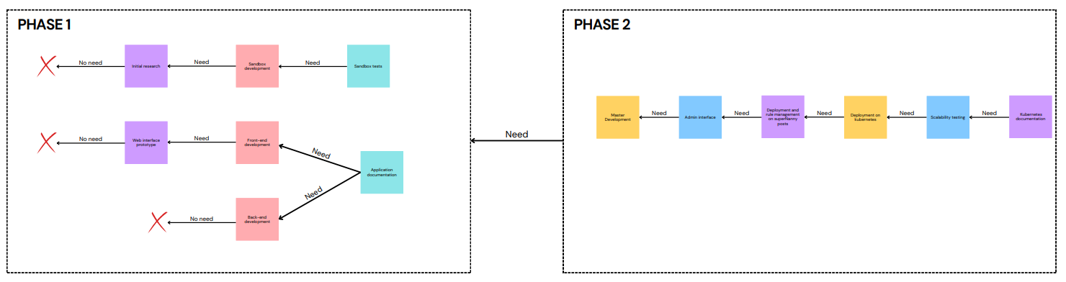
7. Forward planning
CAILLEAUX, CATALA, MATILLA-NORO, VERNANCHET

Slide 19
1
Project content and client
2
Customer requirements
3
Customer constraints
4
Envisioned solution
5
Justification of technical choices
RACI matrix
8
6
WBS organisation
Forward planning
7
CAILLEAUX, CATALA, MATILLA-NORO, VERNANCHET

Slide 20
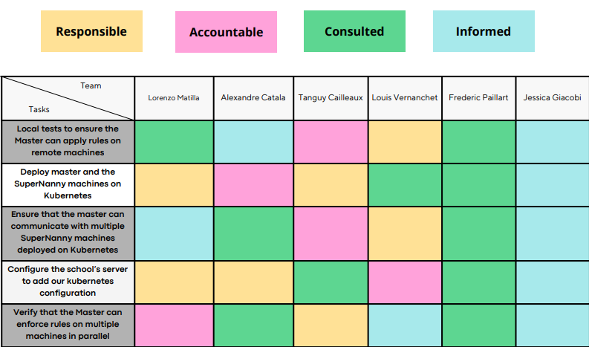
8. RACI matrix
CAILLEAUX, CATALA, MATILLA-NORO, VERNANCHET

Slide 21
1
Project content and client
2
Customer requirements
3
Customer constraints
4
Envisioned solution
Risks matrix
9
5
Justification of technical choices
RACI matrix
8
6
WBS organisation
Forward planning
7
CAILLEAUX, CATALA, MATILLA-NORO, VERNANCHET

Slide 22
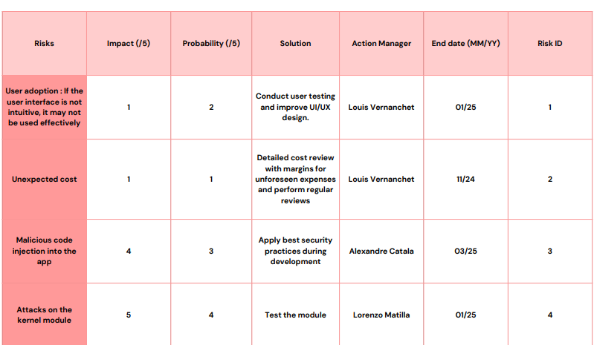
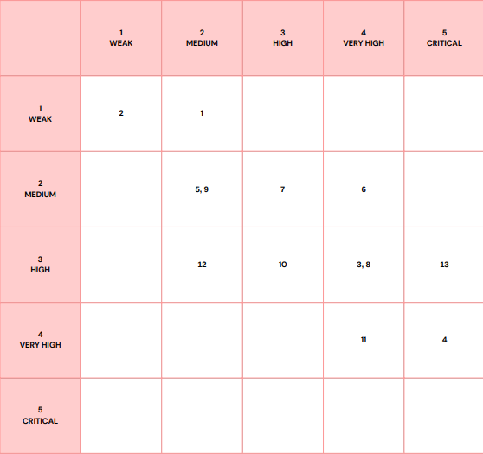
9. Risks matrix
Impact
Probability
CAILLEAUX, CATALA, MATILLA-NORO, VERNANCHET

Slide 23
1
Project content and client
2
Customer requirements
3
Customer constraints
Management methods and steering tools
10
4
Envisioned solution
Risks matrix
9
5
Justification of technical choices
RACI matrix
8
6
WBS organisation
Forward planning
7
CAILLEAUX, CATALA, MATILLA-NORO, VERNANCHET

Slide 24
10. Management methods
Management Approach:
Collaborative methodology that ensured transparency, efficiency, and accountability
Goal:
Effectively distribute tasks, track progress, and ensure timely deliverables using industry-standard tools
GANTT Chart Defining the Timeline
RACI Matrix Task Distribution
Agile Collaboration Continuous Adjustments
Documentation & Risk Management
CAILLEAUX, CATALA, MATILLA-NORO, VERNANCHET
Notes:
2. Key Management Tools & Methods (Left Side of Slide - Bullet Points)
1️⃣ Gantt Chart - Defining the Timeline 📅
A Gantt chart was used to plan and visualize the project's phases over time.
It helped track deadlines, dependencies between tasks, and project milestones (S7, S8, final deliverables).
Key Milestones Included:
Kernel Module Development ✅
Landlock Integration (later switched to eBPF) ✅
System Testing and Security Audits ✅
Final Deployment and Documentation ✅
2️⃣ RACI Matrix - Task Distribution 👥
A RACI (Responsible, Accountable, Consulted, Informed) Matrix was used to assign roles and responsibilities.
It ensured that:
Each team member had clear responsibilities.
No task was left unassigned or unmanaged.
Collaboration between development, deployment, and documentation teams was structured.
Example:
Kernel Development → Alexandre (Responsible) | Louis (Accountable).
Interface Design → Tanguy (Responsible) | Lorenzo (Consulted).
Testing & Validation → Théo (Responsible) | All (Informed).
3️⃣ Agile Collaboration - Continuous Adjustments 🔄
The team regularly adapted to challenges (e.g., switching from Landlock to eBPF & C due to technical limitations).
Weekly meetings helped:
Adjust the timeline if necessary.
Discuss technical obstacles and find solutions collaboratively.
Ensure every member stayed aligned with project objectives.
4️⃣ Documentation & Risk Management 📑
A Risk Matrix was developed to identify, evaluate, and mitigate potential challenges.
Deliverables and documentation were structured to ensure:
Easy future maintenance of SuperNanny.
Clear explanations for implementation and deployment.
A structured, collaborative approach ensured efficient project management.
The Gantt Chart helped track deadlines & milestones.
The RACI Matrix clarified each team member’s role.
Agile adjustments allowed flexibility, especially with technology shifts.
Risk documentation helped prevent major project failures.

Slide 25



10. Management steering tools
Trello (Task Management)
Kanban board
Task tracking
Team assignments
MindView (Planning)
GANTT chart
WBS structure
Timeline & phases
Project Exécution
Clear roadmap
Task completion
Milestone tracking
CAILLEAUX, CATALA, MATILLA-NORO, VERNANCHET

Slide 26
1
Project content and client
2
Customer requirements
Project management methods and applied phases
11
3
Customer constraints
Management methods and steering tools
10
4
Envisioned solution
Risks matrix
9
5
Justification of technical choices
RACI matrix
8
6
WBS organisation
Forward planning
7
CAILLEAUX, CATALA, MATILLA-NORO, VERNANCHET

Slide 27
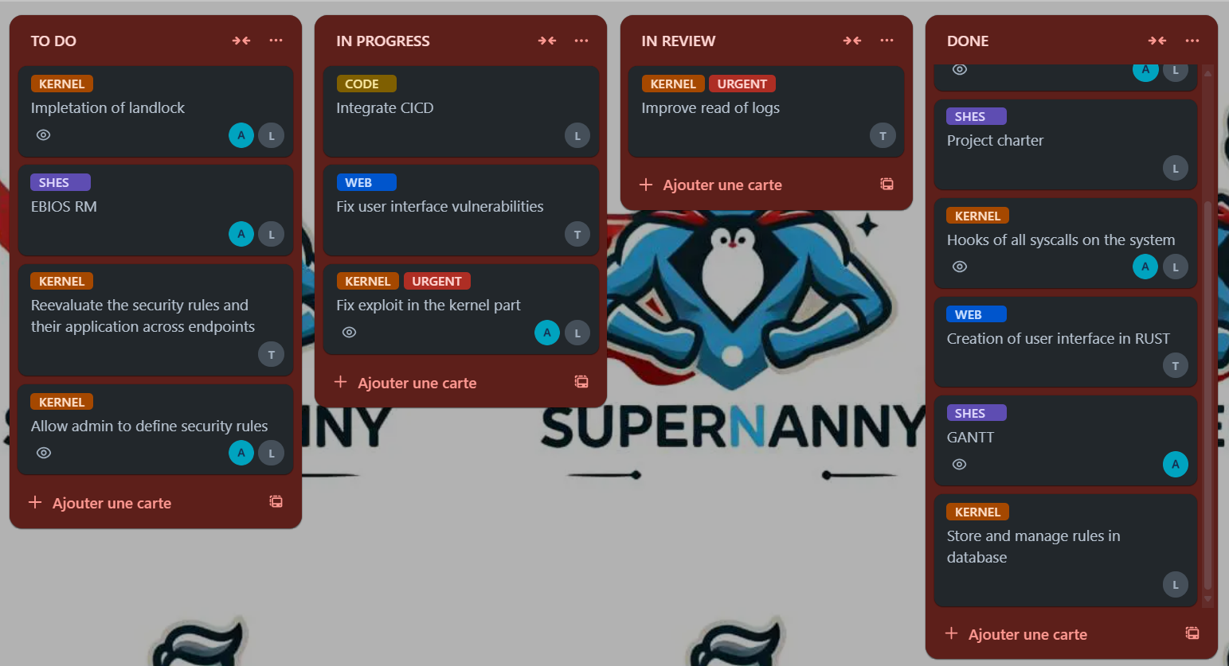
11. Project management methods
CAILLEAUX, CATALA, MATILLA-NORO, VERNANCHET

Slide 28
11. Project management applied phases
Verification
Validation
Project Need
Final Validation
Requirements Phase
System Testing
Design Phase
Integration & Validation
Development Phase
CAILLEAUX, CATALA, MATILLA-NORO, VERNANCHET
Notes:
1️⃣ Project Need → Identification of the security issues in Linux execution monitoring. 2️⃣ Requirements Phase → Customer requirements gathered (security policies, kernel integration, eBPF decision). 3️⃣ Design Phase → Architecture planning (Gantt, WBS, technical stack: eBPF, C, Trello for task management). 4️⃣ Development Phase → Coding the kernel module, database, and user interface. 5️⃣ Integration & Validation → Connecting the system components, ensuring proper permission enforcement. 6️⃣ System Testing → Verifying security policies, execution control, and performance. 7️⃣ Final Validation → Customer validation, ensuring it meets ISEN’s expectations.

Slide 29
1
Project content and client
Progress report
12
2
Customer requirements
Project management methods and applied phases
11
3
Customer constraints
Management methods and steering tools
10
4
Envisioned solution
Risks matrix
9
5
Justification of technical choices
RACI matrix
8
6
WBS organisation
Forward planning
7
CAILLEAUX, CATALA, MATILLA-NORO, VERNANCHET

Slide 30
12. What has been done VS what reamins to be done
Milestones | Status
Detect File access | Syscall detection with tracepoint
Intercept unhautorized folder access | Intercept with kprob
Save user Decisions | Done in a JSON
View and manage rules | On the user interface
Allow file access based on patterns | We did a blacklist, it’s easier to manage
Monitor and log file access events | In log.txt and in the interface
Milestones | Status
Notify user on folder access attempts | Not done
Detect Network access requests | Not done
Notify user on network access | Not done
Intercept unauthorized network access | Not done
Allow network access based on conditions | Not done
Monitor and log network access events | Not done
CAILLEAUX, CATALA, MATILLA-NORO, VERNANCHET

Slide 31


12. Hard points and opportunities
Hard Points | Opportunities
Initial difficulties with Rust & Landlock | Switching to eBPF
Transitioning to eBPF & C | Kernel-level security
Managing syscall interception | Strong academic & real-world value
Creating a user-friendly interface | Improve our Rust developping competences
CAILLEAUX, CATALA, MATILLA-NORO, VERNANCHET

Slide 32



12. Solution cost
Material cost
Production cost
Product cost
License: 5000 €
Subscription: 500€/Year
50 000 €
180 000 €
CAILLEAUX, CATALA, MATILLA-NORO, VERNANCHET
Notes:
📊 Cost Categories
1️⃣ Material Cost (Infrastructure) 💻
Current Phase: ISEN provides servers → 0€ initial cost.
Future Enterprise Deployment:
Dedicated On-Premise Servers: High-performance machines for security execution.
Cloud Hosting (AWS, Azure, GCP): Optional for scalable enterprise solutions.
Estimated Cost per Server: €5000/server.
For Large Deployments (10 servers per company) → €50,000 setup cost per enterprise.
2️⃣ Production Cost (Development) 🛠️
Team Composition:
5 engineers worked on the project.
Average market cost per cybersecurity software engineer: €300/day.
Development Time: ~6 months (≈ 120 working days).
Total Engineering Cost: 5 engineers × €300/day × 120 days = €180,000.
3️⃣ Product Cost (Market & Sales) 💰
Targeted Clients:
Universities & research labs 🏫.
Cybersecurity companies 🔐.
Large enterprises needing execution security 🏢.
Potential Pricing Model:
License-based model → €5000 per organization.
Subscription-based model → €500/year per server.
Projected Break-even Point:
If we sell 40 licenses, the project cost is covered.

Slide 33
Conclusion
13
1
Project content and client
Progress report
12
2
Customer requirements
Project management methods and applied phases
11
3
Customer constraints
Management methods and steering tools
10
4
Envisioned solution
Risks matrix
9
5
Justification of technical choices
RACI matrix
8
6
WBS organisation
Forward planning
7
CAILLEAUX, CATALA, MATILLA-NORO, VERNANCHET

Slide 34



13.Conclusion
Final advancement
Technic/team assestment
Environemental impact
CAILLEAUX, CATALA, MATILLA-NORO, VERNANCHET
Notes:
Final Advancement:
✅ Kernel module development completed with eBPF integration.
✅ Security policies implemented for syscall interception.
✅ Performance and compatibility testing executed successfully.
✅ Documentation structured for future scalability.
Final Things to Do:
Further optimize syscall interception for minimal performance impact.
Improve GUI for non-technical users.
Conduct additional security audits to ensure robustness.
🔹 Prepare for enterprise deployment by defining infrastructure needs.
Technical Assessment:
eBPF proved to be an effective replacement for Landlock.
System performance maintained despite security enforcement.
Scalability with Kubernetes needs further refinement.
Team Assessment:
Strong collaboration using Trello & MindView.
Adaptive problem-solving skills (switching tech stack efficiently).
Better time allocation for testing & debugging needed.
Environetemental impacts:
✅ SuperNanny reduces unnecessary resource usage by optimizing app execution.🔹 Cloud deployment considerations could impact energy consumption.🔹 Future improvement: Implement energy-efficient security monitoring.

Slide 35
Bibliography
Atlassian, B. (s. d.). 9 Best Agile Project Management Tools | Atlassian. Atlassian. https://www.atlassian.com/agile/project-management/tools
Bosworth, R. (2024, 1 avril). The Advantages of eBPF for CWPP Applications. SentinelOne. https://www.sentinelone.com/blog/the-advantages-of-ebpf-for-cwpp-applications
Concurrency - EBPF Docs. (s. d.). https://docs.ebpf.io/linux/concepts/concurrency/
Cyber Security Salary in France | PayScale. (s. d.). https://www.payscale.com/research/FR/Skill=Cyber_Security/Salary
Downs, C., & Downs, C. (2024a, novembre 21). How Much Does a Server Cost For a Small Business in 2024 ? ServerMania. https://www.servermania.com/kb/articles/how-much-does-a-server-cost-for-a-small-business
Downs, C., & Downs, C. (2024b, novembre 21). How Much Does a Server Cost For a Small Business in 2024 ? ServerMania. https://www.servermania.com/kb/articles/how-much-does-a-server-cost-for-a-small-business
Khelil, H. (2024, 8 septembre). Understanding eBPF and Its Application in Modern Cloud Environments 🚀. DEV Community. https://dev.to/hkhelil/understanding-ebpf-and-its-application-in-modern-cloud-environments-3f99
Landau, P. (2024, 6 décembre). 22 Project Management Tools & Techniques for Project Managers. ProjectManager. https://www.projectmanager.com/blog/project-management-techniques-for-every-pm
Team, A. B., & Team, A. B. (2024, 21 mai). How Much Does a Server Cost for a Small Business ? - Abacus. Abacus - Keep your organization secure, supported, and stable with Abacus. https://goabacus.com/how-much-does-a-server-cost-for-a-small-business/
The State of eBPF : Exploring eBPF Evolution, Use Cases, Challenges and Future | DEVOPSdigest. (s. d.). https://www.devopsdigest.com/state-of-ebpf
CAILLEAUX, CATALA, MATILLA-NORO, VERNANCHET

